Slide 1
A Grand Unified Theory of Software
Vinod Dinakaran
Barcamp Bangalore 2012

Slide 2
Kuhn’s Scientific Lifecycle
No science
Pre-science: debate over theory
Normal Science: one generally accepted paradigm
Scientific Revolution: paradigm overthrown

Slide 3
Eg: Largest of 3 numbers
Numbers
2,4,5
5
transform

Slide 4
Problem Solving
Dreams
World Peace
Beauty Pagents
transform

Slide 5
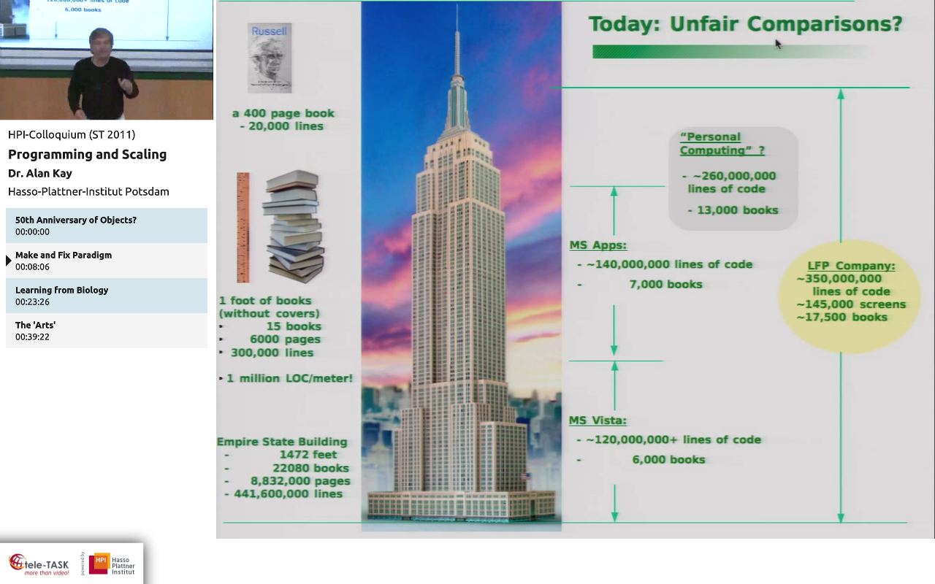

Slide 6
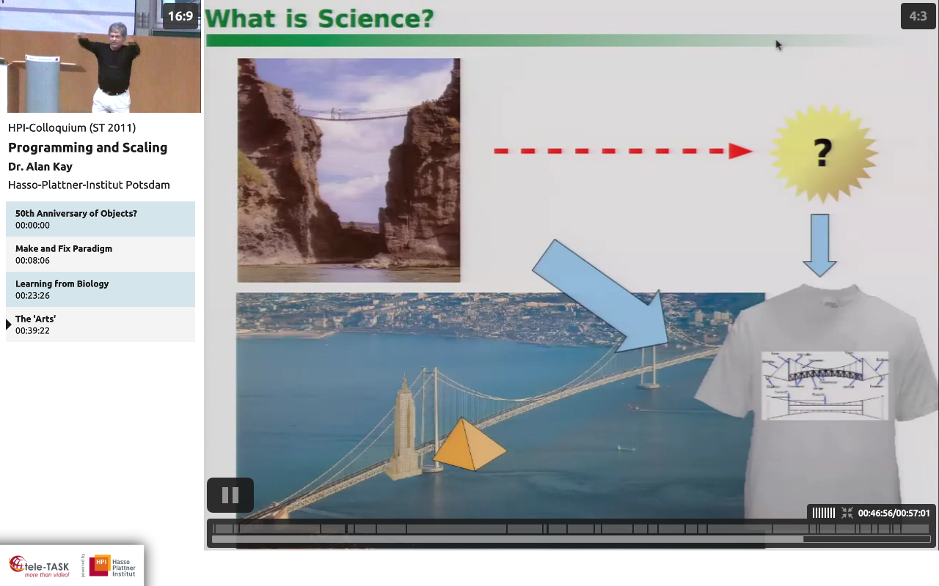

Slide 7
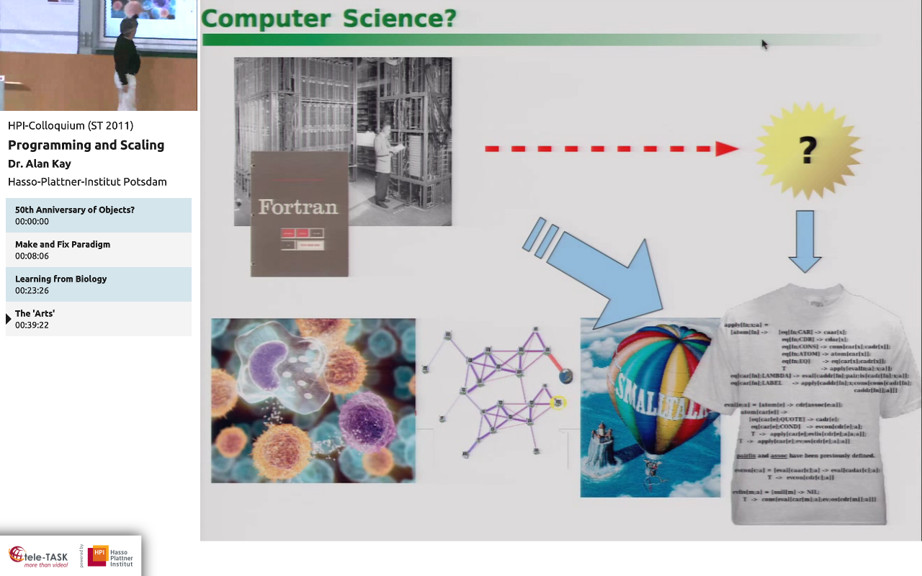

Slide 8
